Slide 1
St. Thomas International Admission Analysis II: Where Did Students Come From?
Morgan Meng
BUAN 620
Final Project

Slide 2
Objectives:
Where did all the TRANSFER students come from? Especially students who transferred from U.S. colleges. And what are the trends?
Where did all the FTFY students come from? Especially students who are in U.S. high school. And what are the trends?
Which areas, schools and states we should start to try developing business in the future?
Build Dashboard PART II prototype for Cognos Dashboard

Slide 3
Background: Understanding Admission Process
Submitted App: Incomplete
Submitted App
Started App
Complete App
File Hold
File Hold
Denial
Confirmed App
Enrolled
Deposit
Admitted

Slide 4
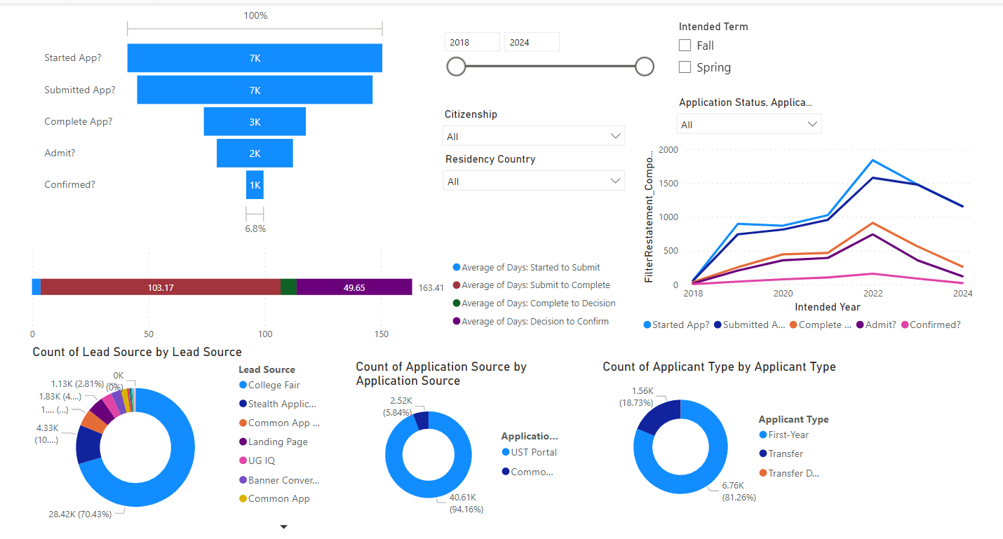
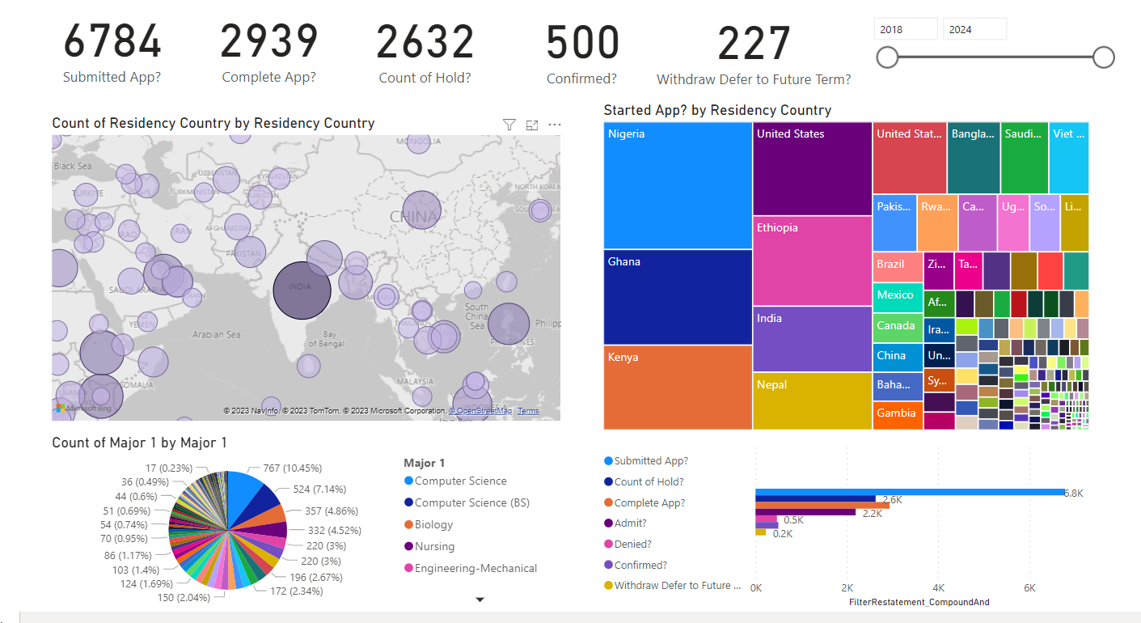
Background: AI Analysis I (Previous)- Power BI Dashboards
Admission Summary
Key KPI & Workload

Slide 5
Data Sources
2023-2025 UST UG Application dataset: Application for a specific term, intended majors and etc.
2023-2025 UST UG Application-Contact dataset: the information about this students.
Education History: EH ID as primary key, stores applicant’s education history, high school or college
School CEEB: high school and post-secondary schools that recognized by College Board will be assigned to a CEEB code (PK).
NCES school geographical dataset: Address and locations for all registered schools in the U.S., using NCES code.
Territory: the countries of students each admission counselor will be responsible
Supporting document data (temp): includes all documents applicants sent but no PK
US VISA issued rate (optional): by month and by country/consulate.
Opportunity (optional): when a student is reached out or contact our school, their info will be recorded as opportunity

Slide 6
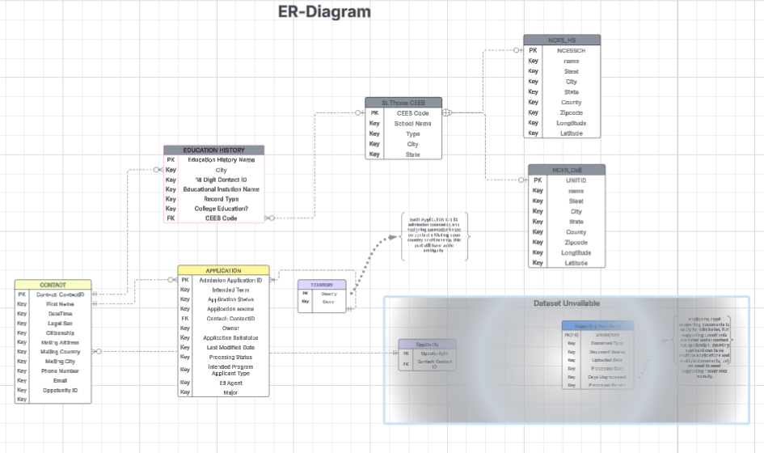
Dataset Relationships

Slide 7
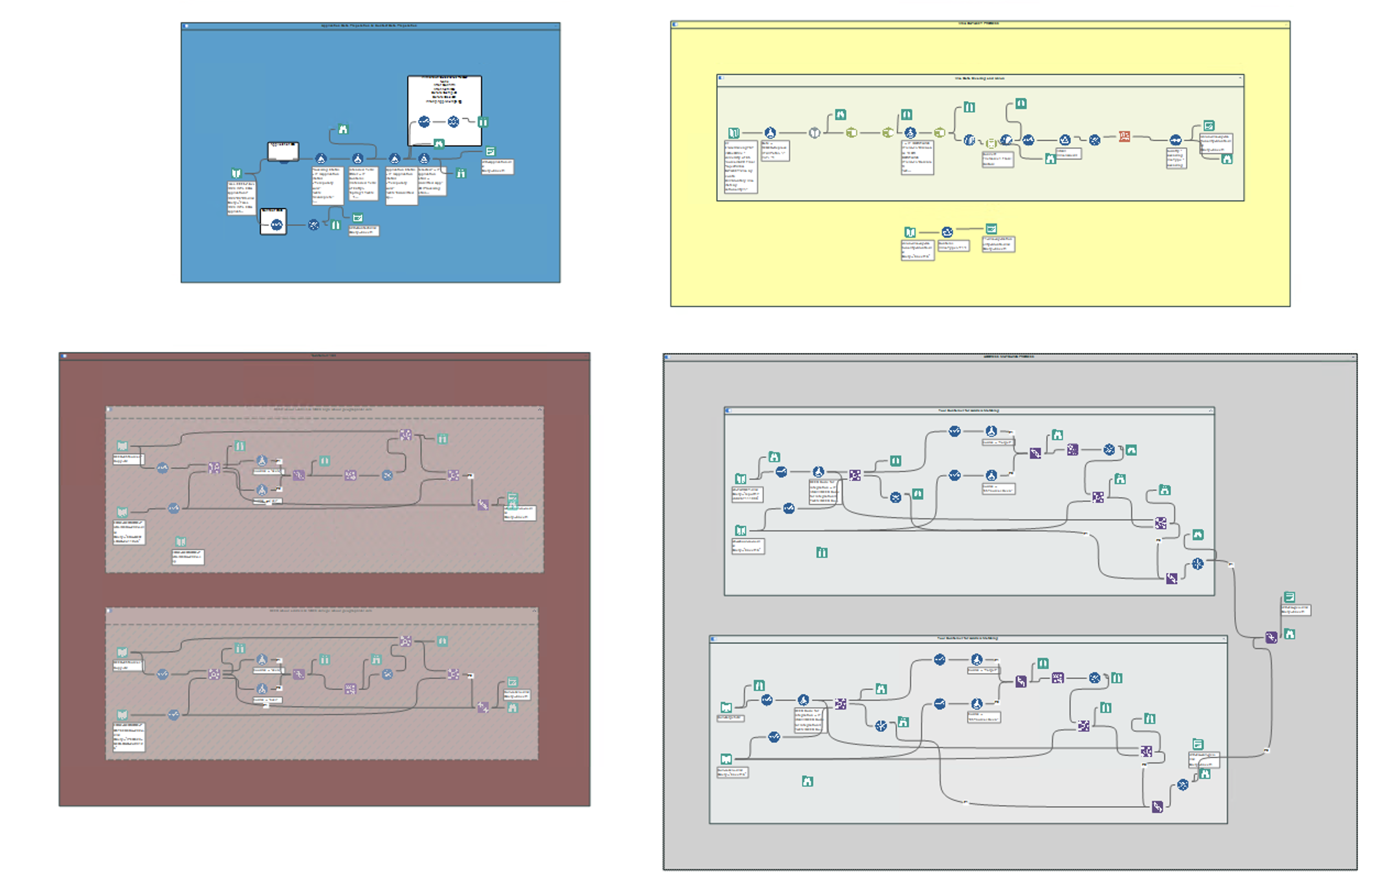
Data Cleaning and Organizing- Alteryx
Dummy Variables for app status
Datetime Cleaning-Up
Dependency Elimination (2NF)
School CEEB Code & NCES Geographical Data Integration
VISA dataset integration

Slide 8
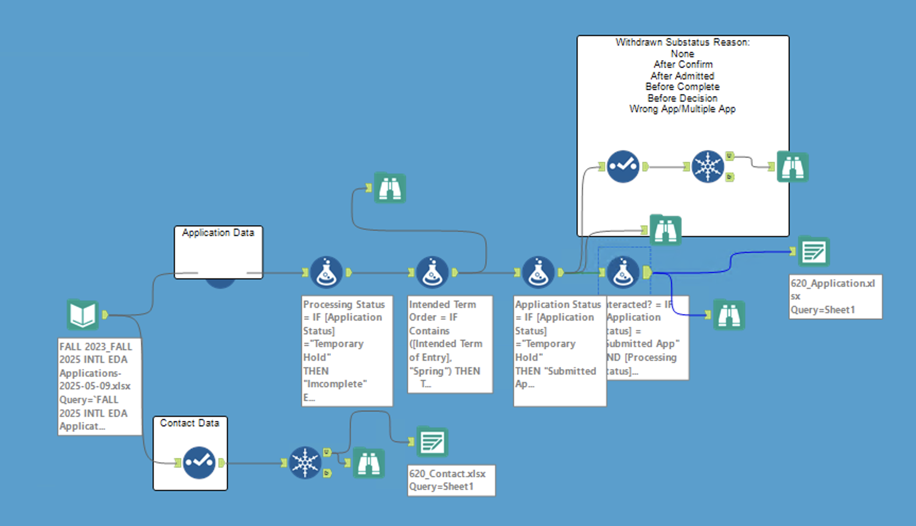
Data Cleaning and Organizing
Dummy Variables for app status
Datetime Cleaning-Up
Dependency Elimination (2NF)

Slide 9
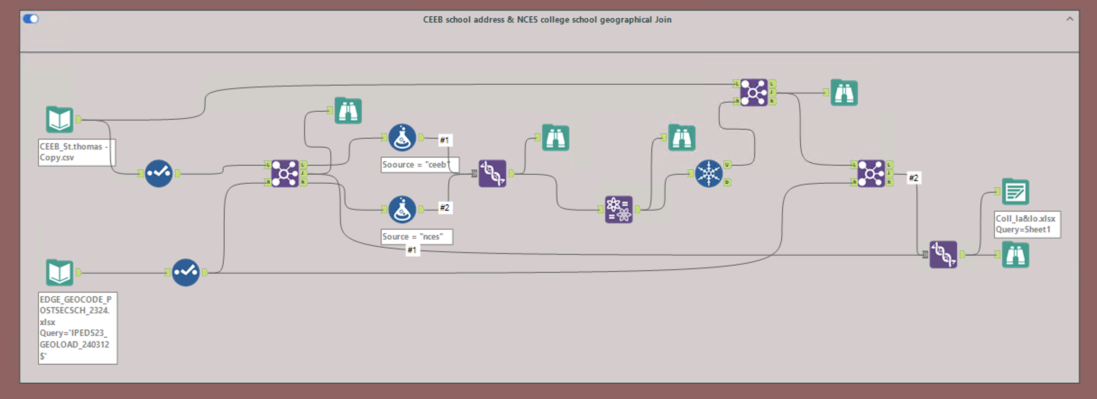
Data Cleaning and Organizing
School CEEB Code & NCES Geographical Data Integration

Slide 10
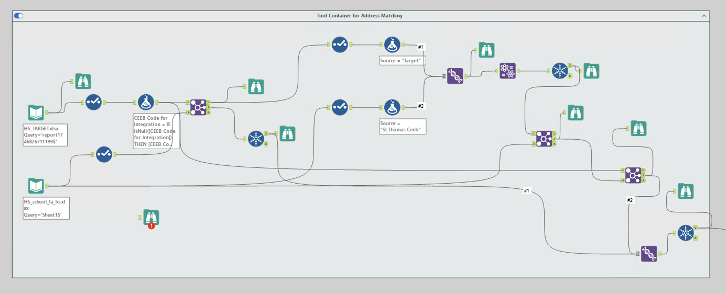
Data Cleaning and Organizing
School CEEB Code & NCES Geographical Data Integration

Slide 11
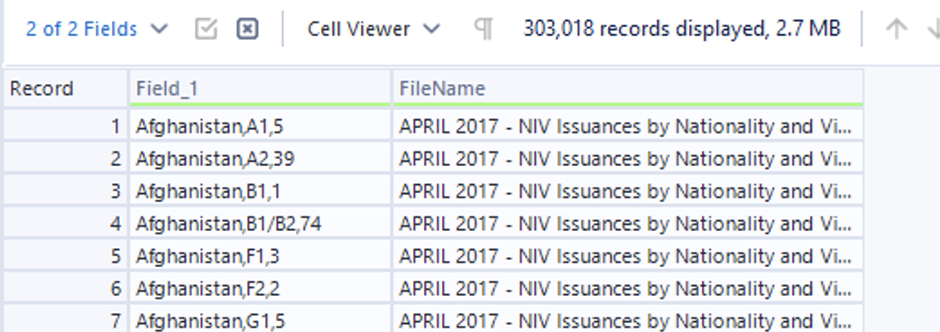
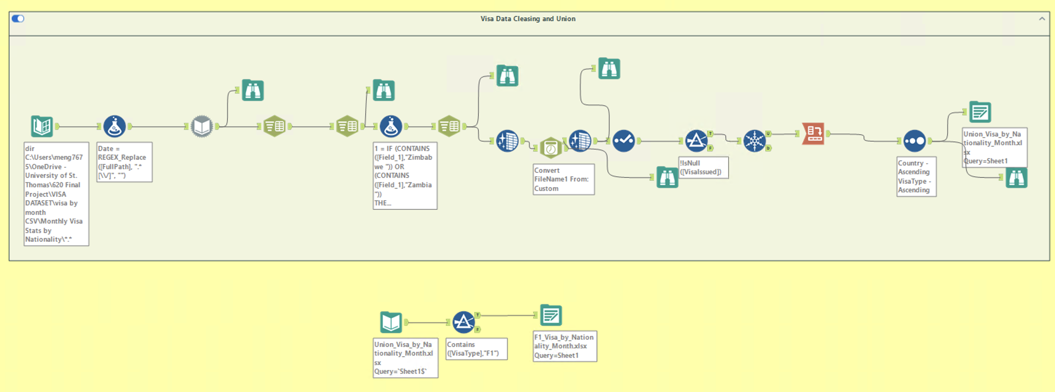
Data Cleaning and Organizing
VISA dataset integration
Format Cleaning
Filename appending

Slide 12

Output Files
“Application. XLSX”
“Contact .XLSX”
“Education History Geo. XLSX”
“F1_Visa_by_Nationality_Month.XLSX”

Slide 13
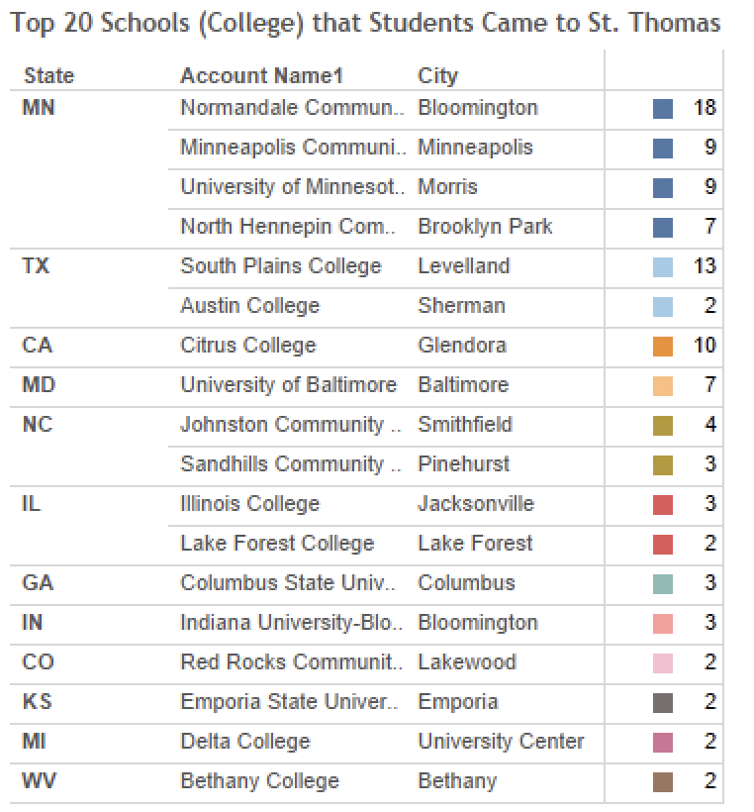
Data Analysis - Tableau
Where did all the TRANSFER students come from? Especially students who transferred from U.S. colleges. And what are the trends?
Mostly from MN community colleges
Students mistaken ”St.Thomas, MN ” as ”St.Thomas, TX ”
CA and MD could the potential recruiting targets.

Slide 14
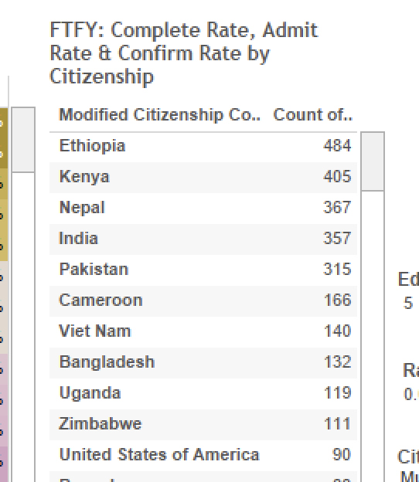
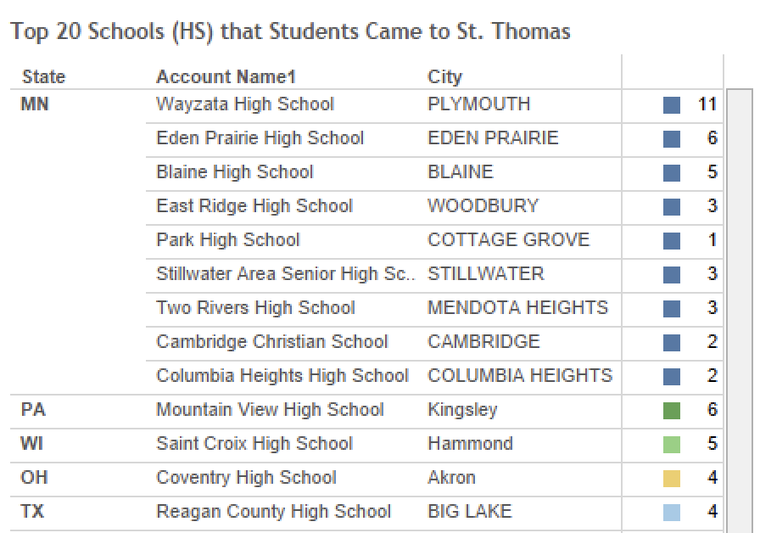
Data Analysis - Tableau
Where did all the TRANSFER students come from? Especially students who transferred from U.S. colleges. And what are the trends?
Mostly from MN high schools
”PA-Mountain View HS” & “OH-Coventry HS” are surprisingly higher applicants.
Comparing to Transfer, more European applicants for FTFY

Slide 15
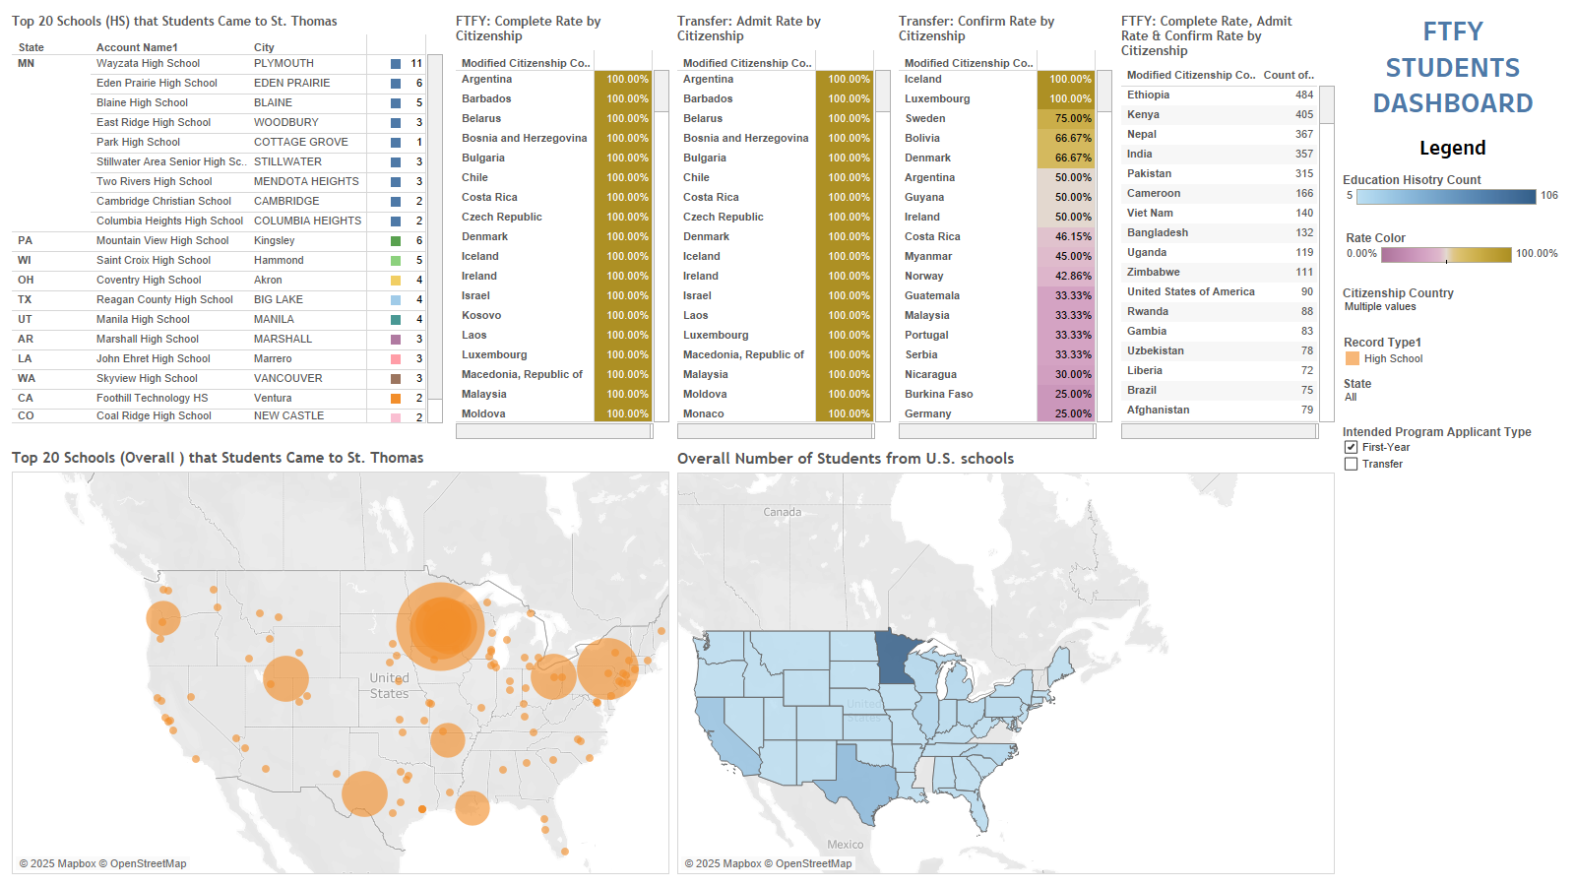
Dashboard - Tableau
Build Dashboard PART II prototype for Cognos Dashboard

Slide 16
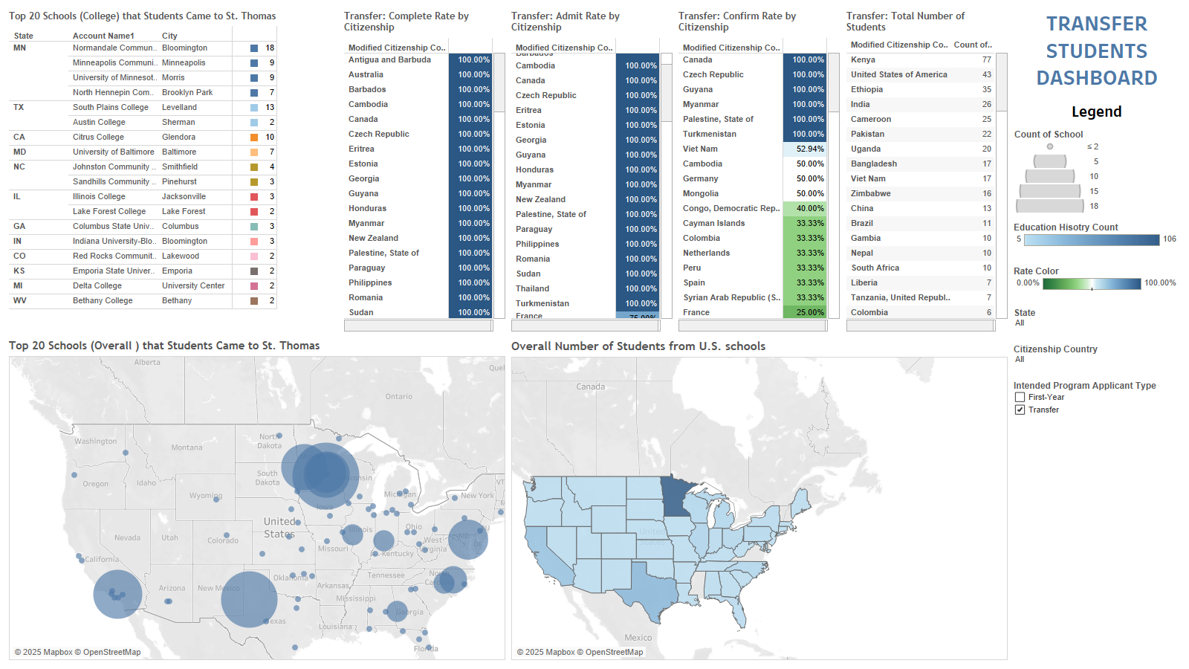
Dashboard - Tableau
Build Dashboard PART II prototype for Cognos Dashboard

Slide 17
NEXT STEP
Build dataset or evaluation model for ”Visa denied rate” or “Denied risk”
Make in-depth case study for universities or high school, finding out how St. Thomas interest them.
Using Visa dataset to build a ML or AI predictive model.
The End! But Wait!

Slide 18
A Tour of the Project

